Slide 1



University Institute of Engineering
DEPARTMENT OF COMPUTER SCIENCE & ENGINEERING
Subject Name: Software Engineering
Subject Code: 23CST-206
Er. Jagmeet Kaur
E8387
ASSISTANT PROFESSOR
CSE
DISCOVER . LEARN . EMPOWER

Slide 2
Topics covered
Function Oriented Design
Data Flow Diagram

Slide 3
Function Oriented Design
In function-oriented design, the system is comprised of many smaller sub-systems known as functions.
These functions are capable of performing significant task in the system.
The system is considered as top view of all functions.
This design mechanism divides the whole system into smaller functions, which provides means of abstraction by concealing the information and their operation.

Slide 4
Function Oriented Design
Another characteristic of functions is that when a program calls a function, the function changes the state of the program, which sometimes is not acceptable by other modules.
Function Oriented design is a method to software design where the model is decomposed into a set of interacting units or modules where each unit or module has a clearly defined function.
Thus, the system is designed from a functional viewpoint.

Slide 5
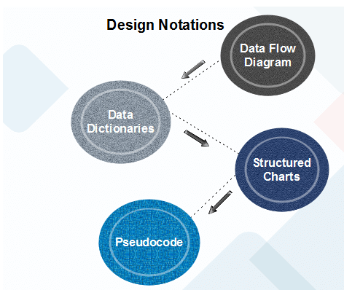
Design Notations
Design Notations are primarily meant to be used during the process of design and are used to represent design or design decisions.
For a function-oriented design, the design can be represented graphically or mathematically by the following:

Slide 6
Data Flow Diagram
Data-flow design is concerned with designing a series of functional transformations that convert system inputs into the required outputs.
The design is described as data-flow diagrams.
These diagrams show how data flows through a system and how the output is derived from the input through a series of functional transformations.
Data-flow design is an integral part of several design methods, and most CASE tools support data-flow diagram creation.
Different ways may use different icons to represent data-flow diagram entities, but their meanings are similar.

Slide 7
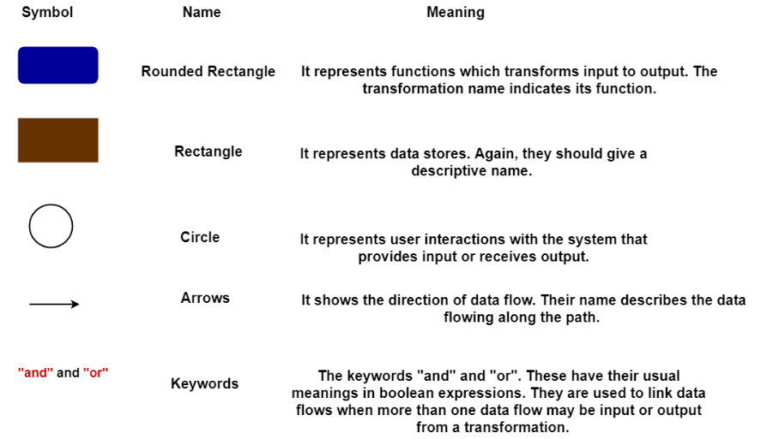
Data Flow Diagram
The notation which is used is based on the following symbols:

Slide 8
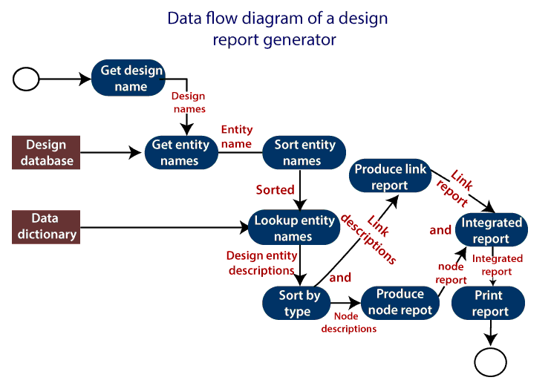
Data Flow Diagram

Slide 9
Example
The report generator produces a report which describes all of the named entities in a data-flow diagram.
The user inputs the name of the design represented by the diagram.
The report generator then finds all the names used in the data-flow diagram.
It looks up a data dictionary and retrieves information about each name.
This is then collated into a report which is output by the system.

Slide 10
REFERENCES
Reference Books:
Suman Ugrasen, “Software Engineering - Concepts and Practices”, First Edition, Cengage.
Mohammad Ali Shaikh, “Software Engineering with UML”, Third Edition, Notion Press.
Somerville Ian, “Software Engineering”, Addison Wesley, 8th Edition.
Text Books:
Pressman Rogers, “Software Engineering: A Practitioner's Approach”, Sixth edition. Patterson and Hennessy, “Computer Architecture” , Fifth Edition Morgaon Kauffman.
Rajib Mall, “Fundamentals of Software Engineering’’, Fourth Edition, Pearson, PHI.
Image references
https://www.javatpoint.com/software-engineering-data-flow-diagrams

Slide 11
THANK YOU

